Slide 1
Otomasi Engine Scoring
23 Sep 2021

Slide 2
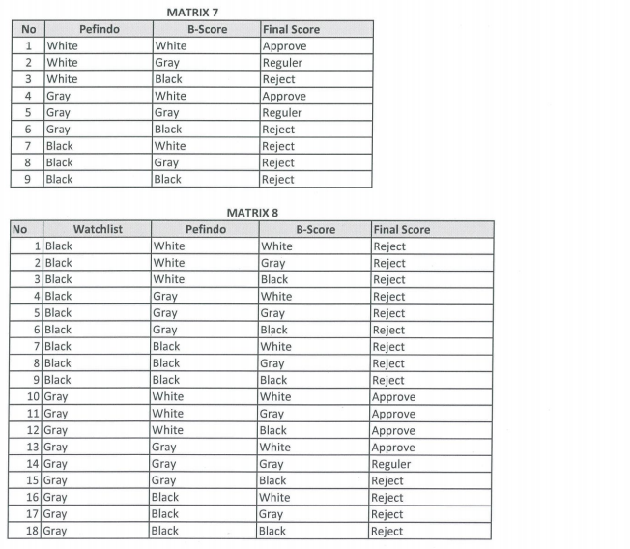

Matriks data engine scoring

Slide 3
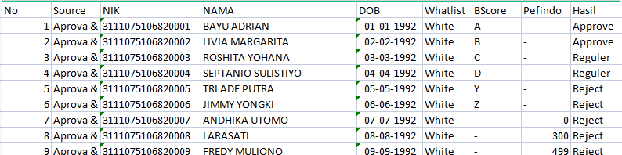
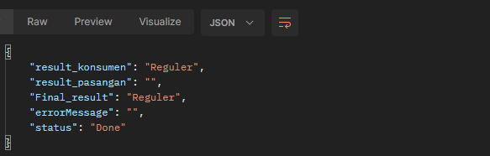
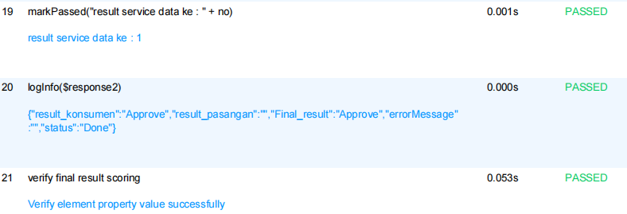
Otomasi
Result
Waktu pengerjaan 39 data : 9m 24s

Slide 4

Thank you

